Slide 1
Data Wrangling: Merging and Working with Multiple Data Tables
Nicholas Mattei, Tulane University
CMPS3660 – Introduction to Data Science – Fall 2019
https://rebrand.ly/TUDataScience
Many Thanks
Slides based off Introduction to Data Science from John P. Dickerson - https://cmsc320.github.io/

Slide 2
Announcements
Project1 and Milestone1 Updates
Reading really important here!
Survey Results!
Lab 4 + Lab 5
Weekly Questions 4
On to DATA!

Slide 3
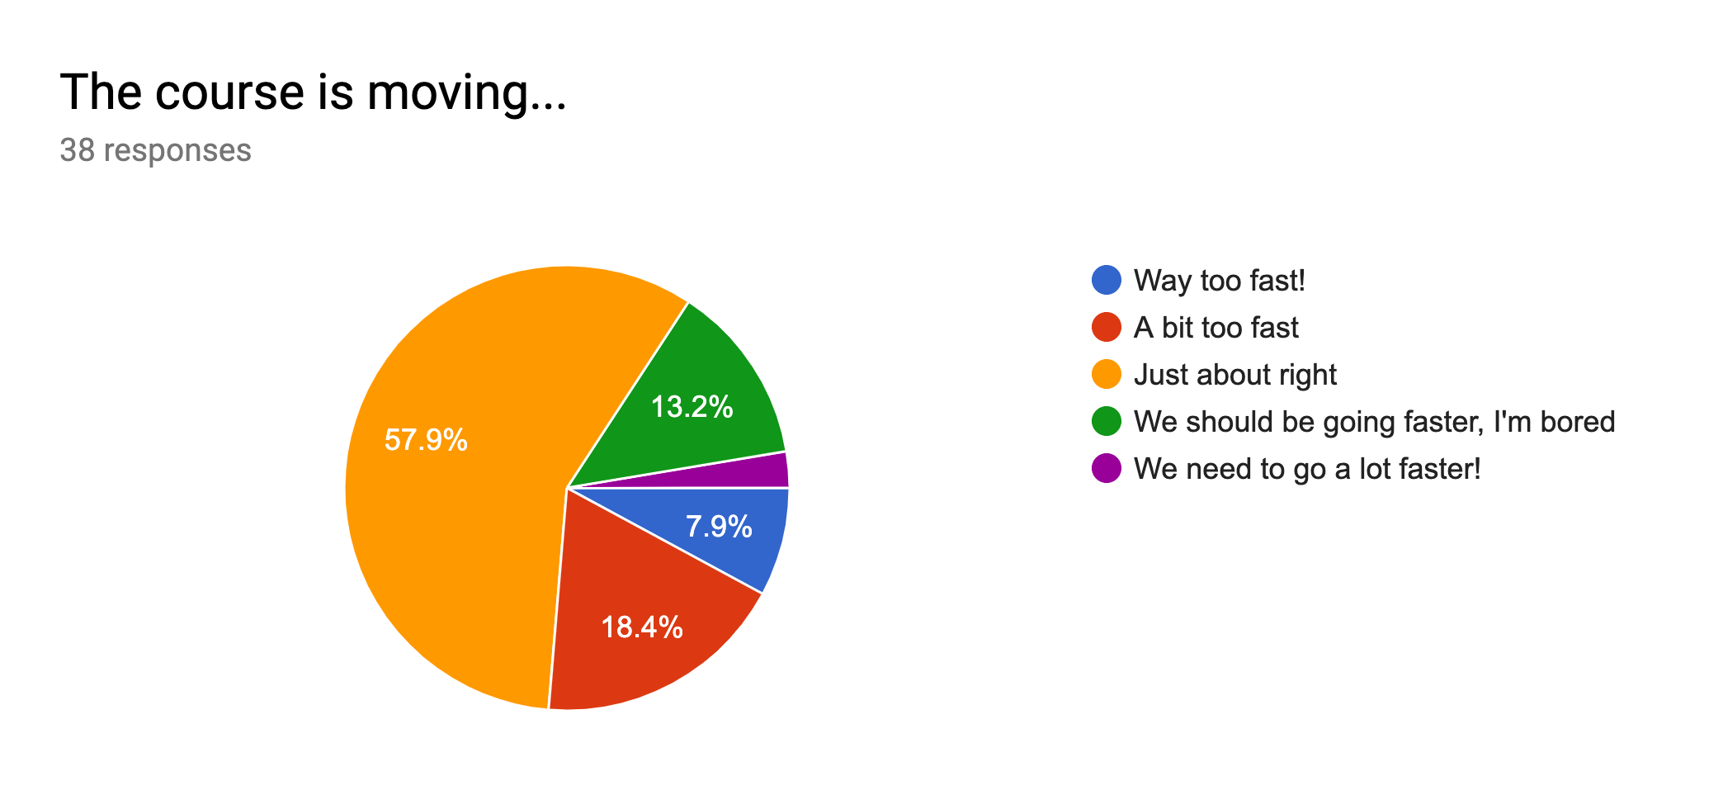
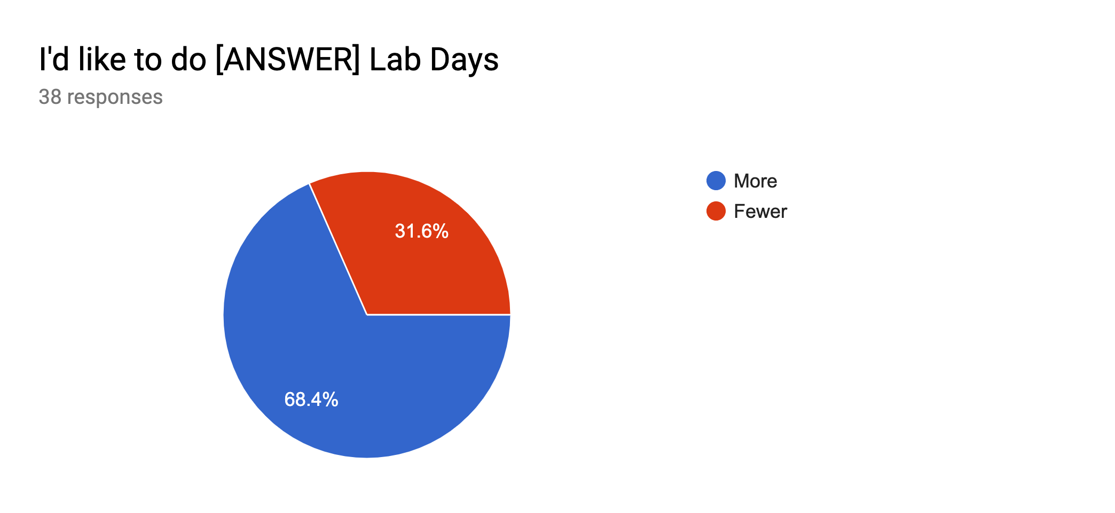
Survey Take Home Messages
28+ of you like or really like notebooks!
2 of you really hate them!
Some of you say I’m talking too fast!
6-7 of you Hate Docker!
What we want (that I’ll deliver):
More Depth, More Theory (5)
PPT/Lectures (5-7)?
Too much, Not enough; interesting, boring; clear, too muddled.
More Feedback!
What we want (I can’t fix).
Class too early.
Too much programming.

Slide 4
Next Couple of Lectures (Till Midterm)
Tables in the Abstract
How, Why
Operations
Principles of Tidy Data
Tables in Pandas
Tables in SQL and RMDBS
2 More Labs.

Slide 5
The Data LifeCycle
Data Collection
Data Processing
Exploratory Analysis
&
Data Visualization
Analysis, Hypothesis Testing,
& ML
Insight
&
Policy Decision
Today

Slide 6
Tables
Special Column, called “Index”, or “ID”, or “Key”
Usually, no duplicates Allowed
Variables
(also called Attributes, or Columns, or Labels)
ID | age | wgt_kg | hgt_cm
1 | 12.2 | 42.3 | 145.1
2 | 11.0 | 40.8 | 143.8
3 | 15.6 | 65.3 | 165.3
4 | 35.1 | 84.2 | 185.8
Observations,
Rows, or
Tuples
Entries or values

Slide 7
1. Select/Slicing
Select only some of the rows, or some of the columns, or a combination.
ID | age
1 | 12.2
2 | 11.0
3 | 15.6
4 | 35.1
ID | age | wgt_kg | hgt_cm
1 | 12.2 | 42.3 | 145.1
2 | 11.0 | 40.8 | 143.8
3 | 15.6 | 65.3 | 165.3
4 | 35.1 | 84.2 | 185.8
Only columns
ID and Age
Both
Only rows with wgt > 41
ID | age
1 | 12.2
3 | 15.6
4 | 35.1
ID | age | wgt_kg | hgt_cm
1 | 12.2 | 42.3 | 145.1
3 | 15.6 | 65.3 | 165.3
4 | 35.1 | 84.2 | 185.8

Slide 8
2. Aggregate/Reduce
Combine values across a column into a single value
73.9 | 232.6 | 640.0
ID | age | wgt_kg | hgt_cm
1 | 12.2 | 42.3 | 145.1
2 | 11.0 | 40.8 | 143.8
3 | 15.6 | 65.3 | 165.3
4 | 35.1 | 84.2 | 185.8
SUM
MAX
35.1 | 84.2 | 185.8
SUM(wgt_kg^2 - hgt_cm)
What about ID/Index column?
Usually not meaningful to aggregate across it
May need to explicitly add an ID column
14167.66

Slide 9
Practical Interlude: np.nan
ID | age | wgt_kg | hgt_cm
1 | 12.2 | 42.3 | 145.1
2 | 11.0 | 40.8 | 143.8
3 | 15.6 | 65.3 | 165.3
4 | -- | 84.2 | 185.8
We use numpy.nan to signify a value is missing or not a number.
If we don’t use NaN’s then Pandas doesn’t know how to handle the data.
Breaks in all sorts of awful ways.
(Demo Notebook)
SUM
ERROR!
ID | age | wgt_kg | hgt_cm
1 | 12.2 | 42.3 | 145.1
2 | 11.0 | 40.8 | 143.8
3 | 15.6 | 65.3 | 165.3
4 | np.NaN | 84.2 | 185.8
SUM
38.8

Slide 10
3. Map
Apply a function to every row, possibly creating more or fewer columns
ID | Address
1 | College Park, MD, 20742
2 | Washington, DC, 20001
3 | Silver Spring, MD 20901
ID | City | State | Zipcode
1 | College Park | MD | 20742
2 | Washington | DC | 20001
3 | Silver Spring | MD | 20901
SPLIT(“,”)
Variations that allow one row to generate multiple rows in the output (sometimes called “flatmap” or “melt” as we’ll see later.)

Slide 11
4. Group By
A = foo
Group tuples together by column/dimension.
ID | B | C
1 | 3 | 6.6
3 | 4 | 3.1
4 | 3 | 8.0
7 | 4 | 2.3
8 | 3 | 8.0
ID | A | B | C
1 | foo | 3 | 6.6
2 | bar | 2 | 4.7
3 | foo | 4 | 3.1
4 | foo | 3 | 8.0
5 | bar | 1 | 1.2
6 | bar | 2 | 2.5
7 | foo | 4 | 2.3
8 | foo | 3 | 8.0
By ‘A’
A = bar
ID | B | C
2 | 2 | 4.7
5 | 1 | 1.2
6 | 2 | 2.5

Slide 12
4. Group By
B = 1
ID | A | C
5 | bar | 1.2
Group tuples together by column/dimension.
B = 2
ID | A | C
2 | bar | 4.7
6 | bar | 2.5
ID | A | B | C
1 | foo | 3 | 6.6
2 | bar | 2 | 4.7
3 | foo | 4 | 3.1
4 | foo | 3 | 8.0
5 | bar | 1 | 1.2
6 | bar | 2 | 2.5
7 | foo | 4 | 2.3
8 | foo | 3 | 8.0
B = 3
By ‘B’
ID | A | C
1 | foo | 6.6
4 | foo | 8.0
8 | foo | 8.0
B = 4
ID | A | C
3 | foo | 3.1
7 | foo | 2.3

Slide 13
4. Group By
Group tuples together by column/dimension.
A = foo, B = 3
A = bar, B = 1
ID | C
1 | 6.6
4 | 8.0
8 | 8.0
ID | A | B | C
1 | foo | 3 | 6.6
2 | bar | 2 | 4.7
3 | foo | 4 | 3.1
4 | foo | 3 | 8.0
5 | bar | 1 | 1.2
6 | bar | 2 | 2.5
7 | foo | 4 | 2.3
8 | foo | 3 | 8.0
ID | C
5 | 1.2
By ‘A’, ‘B’
A = bar, B = 2
ID | C
2 | 4.7
6 | 2.5
A = foo, B = 4
ID | C
3 | 3.1
7 | 2.3

Slide 14
5. Group By Aggregate
B = 1
B = 1
ID | A | C
5 | bar | 1.2
Sum (C)
1.2
B = 2
Group the aggregate per group.
ID | A | C
2 | bar | 4.7
6 | bar | 2.5
B = 2
Sum (C)
7.2
ID | A | B | C
1 | foo | 3 | 6.6
2 | bar | 2 | 4.7
3 | foo | 4 | 3.1
4 | foo | 3 | 8.0
5 | bar | 1 | 1.2
6 | bar | 2 | 2.5
7 | foo | 4 | 2.3
8 | foo | 3 | 8.0
B = 3
B = 3
ID | A | C
1 | foo | 6.6
4 | foo | 8.0
8 | foo | 8.0
Group by ‘B’
Sum on C
Sum (C)
22.6
B = 4
B = 4
Sum (C)
5.4
ID | A | C
3 | foo | 3.1
7 | foo | 2.3

Slide 15
5. Group By Aggregate
B = 1
Sum (C)
1.2
Final result usually seen as a table.
B = 2
Sum (C)
7.2
ID | A | B | C
1 | foo | 3 | 6.6
2 | bar | 2 | 4.7
3 | foo | 4 | 3.1
4 | foo | 3 | 8.0
5 | bar | 1 | 1.2
6 | bar | 2 | 2.5
7 | foo | 4 | 2.3
8 | foo | 3 | 8.0
B | SUM(C )
1 | 1.2
2 | 7.2
3 | 22.6
4 | 5.4
B = 3
Group by ‘B’
Sum on C
Sum (C)
22.6
B = 4
Sum (C)
5.4

Slide 16
5.5 Pivot Tables (Data Cubes)
Laying out the possible values of multiple axes and aggregating them.
Can have more than two dimensions, need hierarchal indexes (later).
ID | A | B | C
1 | foo | 3 | 6.6
2 | bar | 2 | 4.7
3 | foo | 4 | 3.1
4 | foo | 3 | 8.0
5 | bar | 1 | 1.2
6 | bar | 2 | 2.5
7 | foo | 4 | 2.3
8 | foo | 3 | 8.0
A B> | 1 | 2 | 3 | 4
foo | 0 | 0 | 22.6 | 5.4
bar | 1.2 | 7.2 | 0 | 0
Index A, Columns B
Values C, Agg=Sum

Slide 17
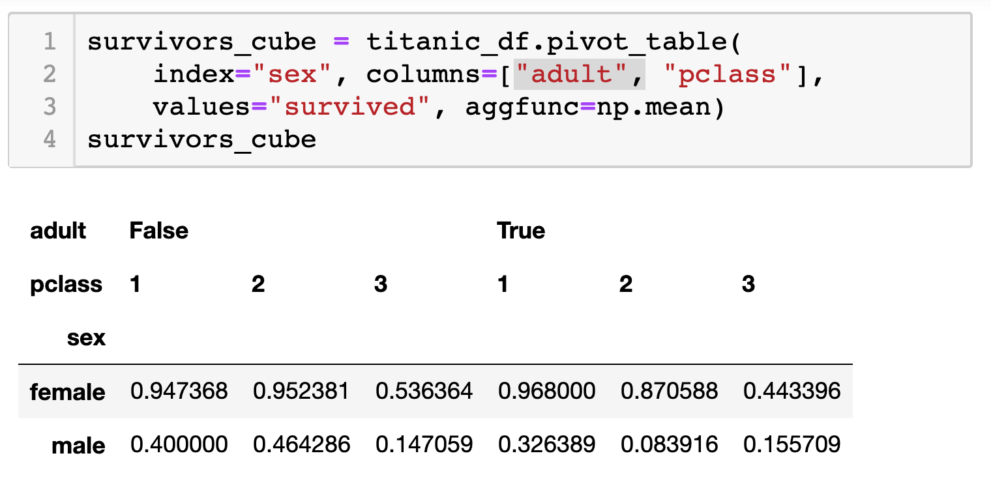
5.5 Pivot Tables (Data Cubes)
Laying out the possible values of multiple axes and aggregating them.
Can have more than two dimensions, need hierarchal indexes (later).

Slide 18
6. Union/Intersection/Difference
Set operations – only if the two tables have identical attributes/columns
ID | A | B | C
1 | foo | 3 | 6.6
2 | bar | 2 | 4.7
3 | foo | 4 | 3.1
4 | foo | 3 | 8.0
5 | bar | 1 | 1.2
6 | bar | 2 | 2.5
7 | foo | 4 | 2.3
8 | foo | 3 | 8.0
ID | A | B | C
1 | foo | 3 | 6.6
2 | bar | 2 | 4.7
3 | foo | 4 | 3.1
4 | foo | 3 | 8.0
ID | A | B | C
5 | bar | 1 | 1.2
6 | bar | 2 | 2.5
7 | foo | 4 | 2.3
8 | foo | 3 | 8.0
U
Similarly Intersection and Set Difference manipulate tables as Sets
IDs may be treated in different ways, resulting in somewhat different behaviors

Slide 19
7. Merge or Join
Combine rows/tuples across two tables if they have the same key.
This example is called an Inner Join
ID | A | B
1 | foo | 3
2 | bar | 2
3 | foo | 4
4 | foo | 3
ID | C
1 | 1.2
2 | 2.5
3 | 2.3
5 | 8.0
ID | A | B | C
1 | foo | 3 | 1.2
2 | bar | 2 | 2.5
3 | foo | 4 | 2.3
⨝
What about IDs not present in both tables?
Often need to keep them around
Can “pad” with NaN (depends on software!)

Slide 20
7. Merge or Join (Outer or Full Join)
Combine rows/tuples across two tables if they have the same key.
Outer joins can be used to ”pad” IDs that don’t appear in both tables
Three variants: LEFT, RIGHT, FULL
SQL Terminology -- Pandas has these operations as well
ID | A | B
1 | foo | 3
2 | bar | 2
3 | foo | 4
4 | foo | 3
ID | C
1 | 1.2
2 | 2.5
3 | 2.3
5 | 8.0
ID | A | B | C
1 | foo | 3 | 1.2
2 | bar | 2 | 2.5
3 | foo | 4 | 2.3
4 | foo | 3 | NaN
5 | NaN | NaN | 8.0
⟗

Slide 21
Types of Joins
In Pandas this is called a FULL OUTTER JOIN!
⨝
⟗
⟕
⟖
Image credit: http://www.dofactory.com/sql/join

Slide 22
7. Merge or Join (Left Join)
Combine rows/tuples across two tables if they have the same key.
Outer joins can be used to ”pad” IDs that don’t appear in both tables
Three variants: LEFT, RIGHT, FULL
SQL Terminology -- Pandas has these operations as well
ID | A | B
1 | foo | 3
2 | bar | 2
3 | foo | 4
4 | foo | 3
ID | C
1 | 1.2
2 | 2.5
3 | 2.3
5 | 8.0
ID | A | B | C
1 | foo | 3 | 1.2
2 | bar | 2 | 2.5
3 | foo | 4 | 2.3
4 | foo | 3 | NaN
⟕

Slide 23
7. Merge or Join (Right Join)
Combine rows/tuples across two tables if they have the same key.
Outer joins can be used to ”pad” IDs that don’t appear in both tables
Three variants: LEFT, RIGHT, FULL
SQL Terminology -- Pandas has these operations as well
ID | A | B
1 | foo | 3
2 | bar | 2
3 | foo | 4
4 | foo | 3
ID | C
1 | 1.2
2 | 2.5
3 | 2.3
5 | 8.0
ID | A | B | C
1 | foo | 3 | 1.2
2 | bar | 2 | 2.5
3 | foo | 4 | 2.3
5 | NaN | NaN | 8.0
⟖

Slide 24
Quick Review
Tables: A simple, common abstraction
Subsumes a set of “strings” – a common input, or a list of lists, or a list of dicts with the same keys.
Operations on tables:
Select, Map, Aggregate, Reduce, Join/Merge, Union/Concat, Group By
These may have different names! In Pandas it’s a merge while in SQL it’s a join.
There can be subtle variations in implementation on different data systems. Remember I’m giving you the high level but you need to read the docs for your software when you use this stuff!

Slide 25
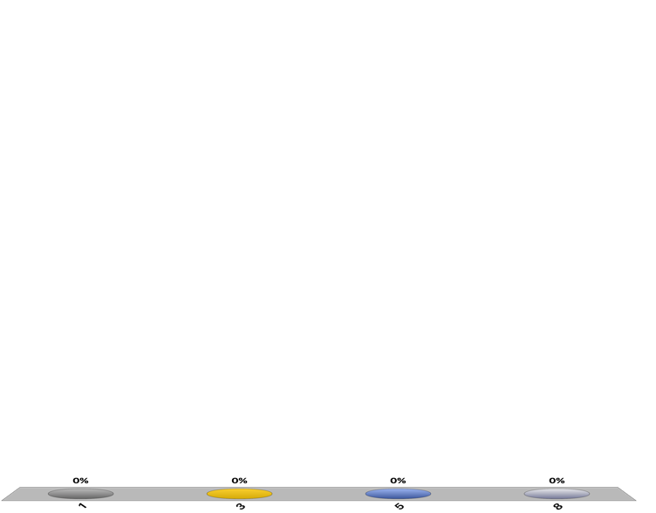
How many tuples in the answer?
A = foo
ID | A | B | C
1 | foo | 3 | 6.6
2 | baz | 2 | 4.7
3 | foo | 4 | 3.1
4 | baz | 3 | 8.0
5 | bar | 1 | 1.2
6 | bar | 2 | 2.5
7 | foo | 4 | 2.3
8 | foo | 3 | 8.0
ID | B | C
1 | 3 | 6.6
3 | 4 | 3.1
7 | 4 | 2.3
8 | 3 | 8.0
A = baz
Group By ‘A’
ID | B | C
2 | 2 | 4.7
4 | 3 | 8.0
A = bar
ID | B | C
5 | 1 | 1.2
6 | 2 | 2.5
Note: A GroupBy should
partition the whole table!
When does it not?
Notes:
3

Slide 26

How many groups in the answer?
A = foo, B=3
A = foo, B=4
ID | C
1 | 6.6
8 | 8.0
ID | C
3 | 3.1
7 | 2.3
ID | A | B | C
1 | foo | 3 | 6.6
2 | baz | 2 | 4.7
3 | foo | 4 | 3.1
4 | baz | 3 | 8.0
5 | bar | 1 | 1.2
6 | bar | 2 | 2.5
7 | foo | 4 | 2.3
8 | foo | 3 | 8.0
Group By ‘A’, ‘B’
A = baz, B=2
A = baz, B=3
ID | C
2 | 4.7
ID | C
4 | 8.0
A = bar, B=1
A = bar, B=2
ID | C
5 | 1.2
ID | C
6 | 2.5
Notes:
(foo,3) (foo,4) (baz, 2) (baz, 3) (bar, 1) (bar, 2) --> 6

Slide 27

How many tuples in the answer?
ID | A | B
1 | foo | 3
2 | bar | 2
4 | foo | 4
5 | foo | 3
ID | C
2 | 1.2
4 | 2.5
6 | 2.3
7 | 8.0
ID | A | B | C
2 | bar | 2 | 1.2
4 | foo | 4 | 2.5
⨝
Notes:
2 – joins on ID = 2 and 4, no match for the others

Slide 28

How many tuples in the answer?
ID | A | B
1 | foo | 3
2 | bar | 2
4 | foo | 4
5 | foo | 3
ID | C
2 | 1.2
4 | 2.5
6 | 2.3
7 | 8.0
ID | A | B | C
1 | foo | 3 | NaN
2 | bar | 2 | 1.2
4 | foo | 4 | 2.5
5 | foo | 3 | NaN
6 | NaN | NaN | 2.3
7 | NaN | NaN | 8.0
⟗
Notes:
Union of IDs --- 1, 2, 4, 5, 6, 7 ---> 6

Slide 29
Pandas: History
Written by: Wes McKinney
Started in 2008 to get a high-performance, flexible tool to perform quantitative analysis on financial data
Highly optimized for performance, with critical code paths written in Cython or C
Key constructs:
Series (like a NumPy Array)
DataFrame (like a Table or Relation, or R data.frame)
Foundation for Data Wrangling and Analysis in Python

Slide 30
Pandas: Series
Subclass of numpy.ndarray
Data: any type
Index labels need not be ordered
Duplicates possible but result in reduced functionality

Slide 31
Pandas: DataFrame
Each column can have a different type
Row and Column index
Mutable size: insert and delete columns
Note the use of word “index” for what we called “key”
Relational databases use “index” to mean something else
Non-unique index values allowed
May raise an exception for some operations

Slide 32
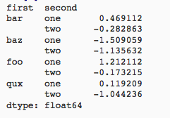
Hierarchical Indexes
Sometimes more intuitive organization of the data
Makes it easier to understand and analyze higher-dimensional data
e.g., instead of 3-D array, may only need a 2-D array
What is a cube in n-dimensions?

Slide 33
Essential Functionality
Reindexing to change the index associated with a DataFrame
Common usage to interpolate, fill in missing values
From: Python for Data Analysis; Wes McKinney

Slide 34
Essential Functionality
“drop” to delete entire rows or columns
Indexing, Selection, Filtering: very similar to NumPy
Arithmetic Operations
Result index union of the two input indexes
Options to do “fill” while doing these operations

Slide 35
Function Application and Mapping
From: Python for Data Analysis; Wes McKinney

Slide 36
Sorting and Ranking
From: Python for Data Analysis; Wes McKinney

Slide 37
Descriptive and Summary Statistics
From: Python for Data Analysis; Wes McKinney

Slide 38
Creating Dataframes
Directly from Dict or Series
From a Comma-Separated File – CSV file
pandas.read_csv()
Can infer headers/column names if present, otherwise may want to reindex
From an Excel File
pandas.read_excel()
From an HTML Table
pandas.read_html()
From a Database using SQL (we’ll see soon…)
From Clipboard, URL, Google Analytics, …
From: Python for Data Analysis; Wes McKinney

Slide 39
More…
Unique values, Value counts
Correlation and Covariance
Functions for handling missing data – in a few classes
dropna(), fillna(), isnull()
Broadcasting
Pivoting
We will (and have) see some of these as we discuss data wrangling, cleaning, etc.

Slide 40
Tidy Data
Variables
Labels
age | wgt_kg | hgt_cm
12.2 | 42.3 | 145.1
11.0 | 40.8 | 143.8
15.6 | 65.3 | 165.3
35.1 | 84.2 | 185.8
Observations
But also:
Names of files/DataFrames = description of one dataset
Enforce one data type per dataset (ish)

Slide 41
Example
Variable: measure or attribute:
age, weight, height, sex
Value: measurement of attribute:
12.2, 42.3kg, 145.1cm, M/F
Observation: all measurements for an object
A specific person is [12.2, 42.3, 145.1, F]
age | wgt_kg | hgt_cm
12.2 | 42.3 | 145.1
11.0 | 40.8 | 143.8
15.6 | 65.3 | 165.3
35.1 | 84.2 | 185.8

Slide 42
Tidying Data I
Name | Treatment A | Treatment B
John Smith | - | 2
Jane Doe | 16 | 11
Mary Johnson | 3 | 1
?????????????
Name | Treatment A | Treatment B | Treatment C | Treatment D
John Smith | - | 2 | - | -
Jane Doe | 16 | 11 | 4 | 1
Mary Johnson | 3 | 1 | - | 2
?????????????
Thanks to http://jeannicholashould.com/tidy-data-in-python.html
Notes:
What if we had treatmeants C, D, E, F

Slide 43
Tidying Data II
In a few lectures …
Name | Treatment | Result
John Smith | A | -
John Smith | B | 2
John Smith | C | -
John Smith | D | -
Jane Doe | A | 16
Jane Doe | B | 11
Jane Doe | C | 4
Jane Doe | D | 1
Mary Johnson | A | 3
Mary Johnson | B | 1
Mary Johnson | C | -
Mary Johnson | D | 2

Slide 44
Melting Data I
religion | <$10k | $10-20k | $20-30k | $30-40k | $40-50k | $50-75k
Agnostic | 27 | 34 | 60 | 81 | 76 | 137
Atheist | 12 | 27 | 37 | 52 | 35 | 70
Buddhist | 27 | 21 | 30 | 34 | 33 | 58
Catholic | 418 | 617 | 732 | 670 | 638 | 1116
Dont know/refused | 15 | 14 | 15 | 11 | 10 | 35
Evangelical Prot | 575 | 869 | 1064 | 982 | 881 | 1486
Hindu | 1 | 9 | 7 | 9 | 11 | 34
Historically Black Prot | 228 | 244 | 236 | 238 | 197 | 223
Jehovahs Witness | 20 | 27 | 24 | 24 | 21 | 30
Jewish | 19 | 19 | 25 | 25 | 30 | 95
?????????????

Slide 45
Melting Data II
f_df = pd.melt(df,
["religion"],
var_name="income",
value_name="freq")
f_df = f_df.sort_values(by=["religion"])
f_df.head(10)
religion | income | freq
Agnostic | <$10k | 27
Agnostic | $30-40k | 81
Agnostic | $40-50k | 76
Agnostic | $50-75k | 137
Agnostic | $10-20k | 34
Agnostic | $20-30k | 60
Atheist | $40-50k | 35
Atheist | $20-30k | 37
Atheist | $10-20k | 27
Atheist | $30-40k | 52

Slide 46
More Complicated Example
Billboard Top 100 data for songs, position on the Top 100 for 75 weeks, with two “messy” bits:
Column headers for each of the 75 weeks
If a song didn’t last 75 weeks, those columns have are null
year | artist.inverted | track | time | genre | date.entered | date.peaked | x1st.week | x2nd.week | ...
2000 | Destiny's Child | Independent Women Part I | 3:38 | Rock | 2000-09-23 | 2000-11-18 | 78 | 63.0 | ...
2000 | Santana | Maria, Maria | 4:18 | Rock | 2000-02-12 | 2000-04-08 | 15 | 8.0 | ...
2000 | Savage Garden | I Knew I Loved You | 4:07 | Rock | 1999-10-23 | 2000-01-29 | 71 | 48.0 | ...
2000 | Madonna | Music | 3:45 | Rock | 2000-08-12 | 2000-09-16 | 41 | 23.0 | ...
2000 | Aguilera, Christina | Come On Over Baby | 3:38 | Rock | 2000-08-05 | 2000-10-14 | 57 | 47.0 | ...
2000 | Janet | Doesn't Really Matter | 4:17 | Rock | 2000-06-17 | 2000-08-26 | 59 | 52.0 | ...
Messy columns!
Thanks to http://jeannicholashould.com/tidy-data-in-python.html

Slide 47
More Complicated Example
# Keep identifier variables
id_vars = ["year",
"artist.inverted",
"track",
"time",
"genre",
"date.entered",
"date.peaked"]
# Melt the rest into week and rank columns
df = pd.melt(frame=df,
id_vars=id_vars,
var_name="week",
value_name="rank")
Creates one row per week, per record, with its rank

Slide 48
More Complicated Example
# Formatting
df["week"] = df['week'].str.extract('(\d+)’,
expand=False).astype(int)
df["rank"] = df["rank"].astype(float)
[…, “x2nd.week”, 63.0] → […, 2, 63]
# Cleaning out unnecessary rows
df = df.dropna()
# Create "date" columns
df['date'] = pd.to_datetime(
df['date.entered']) +
pd.to_timedelta(df['week'], unit='w') –
pd.DateOffset(weeks=1)

Slide 49
More Complicated Example
# Ignore now-redundant, messy columns
df = df[["year",
"artist.inverted",
"track",
"time",
"genre",
"week",
"rank",
"date"]]
df = df.sort_values(ascending=True,
by=["year","artist.inverted","track","week","rank"])
# Keep tidy dataset for future usage
billboard = df
df.head(10)

Slide 50
More Complicated Example
year | artist.inverted | track | time | genre | week | rank | date
2000 | 2 Pac | Baby Don't Cry (Keep Ya Head Up II) | 4:22 | Rap | 1 | 87 | 2000-02-26
2000 | 2 Pac | Baby Don't Cry (Keep Ya Head Up II) | 4:22 | Rap | 2 | 82 | 2000-03-04
2000 | 2 Pac | Baby Don't Cry (Keep Ya Head Up II) | 4:22 | Rap | 3 | 72 | 2000-03-11
2000 | 2 Pac | Baby Don't Cry (Keep Ya Head Up II) | 4:22 | Rap | 4 | 77 | 2000-03-18
2000 | 2 Pac | Baby Don't Cry (Keep Ya Head Up II) | 4:22 | Rap | 5 | 87 | 2000-03-25
2000 | 2 Pac | Baby Don't Cry (Keep Ya Head Up II) | 4:22 | Rap | 6 | 94 | 2000-04-01
2000 | 2 Pac | Baby Don't Cry (Keep Ya Head Up II) | 4:22 | Rap | 7 | 99 | 2000-04-08
2000 | 2Ge+her | The Hardest Part Of Breaking Up (Is Getting Ba... | 3:15 | R&B | 1 | 91 | 2000-09-02
2000 | 2Ge+her | The Hardest Part Of Breaking Up (Is Getting Ba... | 3:15 | R&B | 2 | 87 | 2000-09-09
2000 | 2Ge+her | The Hardest Part Of Breaking Up (Is Getting Ba... | 3:15 | R&B | 3 | 92 | 2000-09-16
?????????????

Slide 51
More To Do?
Column headers are values, not variable names?
Good to go!
Multiple variables are stored in one column?
Maybe (depends on if genre text in raw data was multiple)
Variables are stored in both rows and columns?
Good to go!
Multiple types of observational units in the same table?
Good to go! One row per song’s week on the Top 100.
A single observational unit is stored in multiple tables?
Don’t do this!
Repetition of data?
Lots! Artist and song title’s text names. Which leads us to …

Slide 52
Today’s Lecture
Relational data:
What is a relation, and how do they interact?
Querying databases:
SQL
SQLite
How does this relate to pandas?
Joins
Thanks to Zico Kolter for some structure for this lecture!

Slide 53
Relation
Simplest relation: a table aka tabular data full of unique tuples
Variables
(called attributes)
Labels
ID | age | wgt_kg | hgt_cm
1 | 12.2 | 42.3 | 145.1
2 | 11.0 | 40.8 | 143.8
3 | 15.6 | 65.3 | 165.3
4 | 35.1 | 84.2 | 185.8
Observations
(called tuples)

Slide 54
Primary keys
ID | age | wgt_kg | hgt_cm | nat_id
1 | 12.2 | 42.3 | 145.1 | 1
2 | 11.0 | 40.8 | 143.8 | 1
3 | 15.6 | 65.3 | 165.3 | 2
4 | 35.1 | 84.2 | 185.8 | 1
5 | 18.1 | 62.2 | 176.2 | 3
6 | 19.6 | 82.1 | 180.1 | 1
ID | Nationality
1 | USA
2 | Canada
3 | Mexico
The primary key is a unique identifier for every tuple in a relation
Each tuple has exactly one primary key

Slide 55
Aren’t these called “indexes”?
Yes, in Pandas; but not in the database world
For most databases, an “index” is a data structure used to speed up retrieval of specific tuples
For example, to find all tuples with nat_id = 2:
We can either scan the table – O(N)
Or use an “index” (e.g., binary tree) – O(log N)

Slide 56
Foreign keys
ID | age | wgt_kg | hgt_cm | nat_id
1 | 12.2 | 42.3 | 145.1 | 1
2 | 11.0 | 40.8 | 143.8 | 1
3 | 15.6 | 65.3 | 165.3 | 2
4 | 35.1 | 84.2 | 185.8 | 1
5 | 18.1 | 62.2 | 176.2 | 3
6 | 19.6 | 82.1 | 180.1 | 1
ID | Nationality
1 | USA
2 | Canada
3 | Mexico
Foreign keys are attributes (columns) that point to a different table’s primary key
A table can have multiple foreign keys

Slide 57
Relation Schema
A list of all the attribute names, and their domains
create table department
(dept_name varchar(20),
building varchar(15),
budget numeric(12,2) check (budget > 0),
primary key (dept_name)
);
SQL Statements
To create Tables
create table instructor (
ID char(5), name varchar(20) not null, dept_name varchar(20), salary numeric(8,2),
primary key (ID), foreign key (dept_name) references department
)

Slide 58
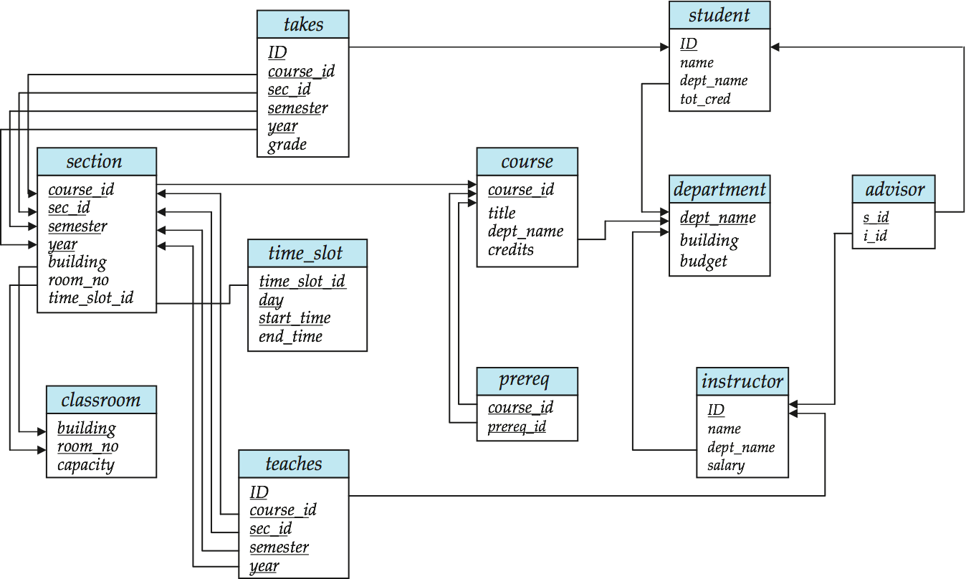
Schema Diagrams

Slide 59
Searching for elements
Find all people with nationality Canada (nat_id = 2):
???????????????
ID | age | wgt_kg | hgt_cm | nat_id
1 | 12.2 | 42.3 | 145.1 | 1
2 | 11.0 | 40.8 | 143.8 | 1
3 | 15.6 | 65.3 | 165.3 | 2
4 | 35.1 | 84.2 | 185.8 | 1
5 | 18.1 | 62.2 | 176.2 | 3
6 | 19.6 | 82.1 | 180.1 | 1
O(n)

Slide 60
Indexes
Like a hidden sorted map of references to a specific attribute (column) in a table; allows O(log n) lookup instead of O(n)
loc | ID | age | wgt_kg | hgt_cm | nat_id
0 | 1 | 12.2 | 42.3 | 145.1 | 1
128 | 2 | 11.0 | 40.8 | 143.8 | 2
256 | 3 | 15.6 | 65.3 | 165.3 | 2
384 | 4 | 35.1 | 84.2 | 185.8 | 1
512 | 5 | 18.1 | 62.2 | 176.2 | 3
640 | 6 | 19.6 | 82.1 | 180.1 | 1
nat_id | locs
1 | 0, 384, 640
2 | 128, 256
3 | 512

Slide 61
INdexes
Actually implemented with data structures like B-trees
(Take courses like CMSC424 or CMSC420)
But: indexes are not free
Takes memory to store
Takes time to build
Takes time to update (add/delete a row, update the column)
But, but: one index is (mostly) free
Index will be built automatically on the primary key
Think before you build/maintain an index on other attributes!

Slide 62
Relationships
Primary keys and foreign keys define interactions between different tables aka entities. Four types:
One-to-one
One-to-one-or-none
One-to-many and many-to-one
Many-to-many
Connects (one, many) of the rows in one table to (one, many) of the rows in another table

Slide 63
One-to-many & Many-to-one
One person can have one nationality in this example, but one nationality can include many people.
Person
Nationality
ID | age | wgt_kg | hgt_cm | nat_id
1 | 12.2 | 42.3 | 145.1 | 1
2 | 11.0 | 40.8 | 143.8 | 1
3 | 15.6 | 65.3 | 165.3 | 2
4 | 35.1 | 84.2 | 185.8 | 1
5 | 18.1 | 62.2 | 176.2 | 3
6 | 19.6 | 82.1 | 180.1 | 1
ID | Nationality
1 | USA
2 | Canada
3 | Mexico

Slide 64
One-to-One
Two tables have a one-to-one relationship if every tuple in the first tables corresponds to exactly one entry in the other
In general, you won’t be using these (why not just merge the rows into one table?) unless:
Split a big row between SSD and HDD or distributed
Restrict access to part of a row (some DBMSs allow column-level access control, but not all)
Caching, partitioning, & serious stuff: take CMSC424
Person
SSN

Slide 65
One-to-One-Or-None
Say we want to keep track of people’s cats:
People with IDs 2 and 3 do not own cats*, and are not in the table. Each person has at most one entry in the table.
Is this data tidy?
Person ID | Cat1 | Cat2
1 | Chairman Meow | Fuzz Aldrin
4 | Anderson Pooper | Meowly Cyrus
5 | Gigabyte | Megabyte
Person
Cat
*nor do they have hearts, apparently.

Slide 66
Many-to-Many
Say we want to keep track of people’s cats’ colorings:
One column per color, too many columns, too many nulls
Each cat can have many colors, and each color many cats
ID | Name
1 | Megabyte
2 | Meowly Cyrus
3 | Fuzz Aldrin
4 | Chairman Meow
5 | Anderson Pooper
6 | Gigabyte
Cat ID | Color ID | Amount
1 | 1 | 50
1 | 2 | 50
2 | 2 | 20
2 | 4 | 40
2 | 5 | 40
3 | 1 | 100
Cat
Color

Slide 67
Associative tables
Cats
Colors
Cat ID | Color ID | Amount
1 | 1 | 50
1 | 2 | 50
2 | 2 | 20
2 | 4 | 40
2 | 5 | 40
3 | 1 | 100
ID | Name
1 | Megabyte
2 | Meowly Cyrus
3 | Fuzz Aldrin
4 | Chairman Meow
5 | Anderson Pooper
6 | Gigabyte
ID | Name
1 | Black
2 | Brown
3 | White
4 | Orange
5 | Neon Green
6 | Invisible
Primary key ???????????
[Cat ID, Color ID] (+ [Color ID, Cat ID], case-dependent)
Foreign key(s) ???????????
Cat ID and Color ID

Slide 68
Aside: Pandas
So, this kinda feels like pandas …
And pandas kinda feels like a relational data system …
Pandas is not strictly a relational data system:
No notion of primary / foreign keys
It does have indexes (and multi-column indexes):
pandas.Index: ordered, sliceable set storing axis labels
pandas.MultiIndex: hierarchical index
Rule of thumb: do heavy, rough lifting at the relational DB level, then fine-grained slicing and dicing and viz with pandas

Slide 69
SQLite
On-disk relational database management system (RDMS)
Applications connect directly to a file
Most RDMSs have applications connect to a server:
Advantages include greater concurrency, less restrictive locking
Disadvantages include, for this class, setup time ☺
Installation:
conda install -c anaconda sqlite
(Should come preinstalled, I think?)
All interactions use Structured Query Language (SQL)

Slide 70
How a relational DB fits into your workflow
Persists!
Raw Input
Python
SQLite File
SQL
SQL
Structured output (trained classifiers, JSON for D3, visualizations)
SQLite CLI & GUI Frontend
Persists!

Slide 71
Crash Course in SQL (in python)
import sqlite3
# Create a database and connect to it
conn = sqlite3.connect(“cmsc320.db”)
cursor = conn.cursor()
# do cool stuff
conn.close()
Cursor: temporary work area in system memory for manipulating SQL statements and return values
If you do not close the connection (conn.close()), any outstanding transaction is rolled back
(More on this in a bit.)

Slide 72
Crash Course in SQL (in python)
# Make a table
cursor.execute(“””
CREATE TABLE cats (
id INTEGER PRIMARY KEY,
name TEXT
)”””)
?????????
id | name
cats
Capitalization doesn’t matter for SQL reserved words
SELECT = select = SeLeCt
Rule of thumb: capitalize keywords for readability

Slide 73
Crash Course in SQL (in python)
# Insert into the table
cursor.execute(“INSERT INTO cats VALUE (1, ’Megabyte’)”)
cursor.execute(“INSERT INTO cats VALUE (2, ‘Meowly Cyrus’)”)
cursor.execute(“INSERT INTO cats VALUE (3, ‘Fuzz Aldrin’)”)
conn.commit()
id | name
1 | Megabyte
2 | Meowly Cyrus
3 | Fuzz Aldrin
# Delete row(s) from the table
cursor.execute(“DELETE FROM cats WHERE id == 2”);
conn.commit()
id | name
1 | Megabyte
3 | Fuzz Aldrin

Slide 74
Crash Course in SQL (in python)
# Read all rows from a table
for row in cursor.execute(”SELECT * FROM cats”):
print(row)
# Read all rows into pandas DataFrame
pd.read_sql_query(“SELECT * FROM cats”, conn, index_col=”id”)
id | name
1 | Megabyte
3 | Fuzz Aldrin
index_col=“id”: treat column with label “id” as an index
index_col=1: treat column #1 (i.e., “name”) as an index
(Can also do multi-indexing.)

Slide 75
Joining data
A join operation merges two or more tables into a single relation. Different ways of doing this:
Inner
Left
Right
Full Outer
Join operations are done on columns that explicitly link the tables together

Slide 76
Inner Joins
id | name
1 | Megabyte
2 | Meowly Cyrus
3 | Fuzz Aldrin
4 | Chairman Meow
5 | Anderson Pooper
6 | Gigabyte
cat_id | last_visit
1 | 02-16-2017
2 | 02-14-2017
5 | 02-03-2017
visits
cats
Inner join returns merged rows that share the same value in the column they are being joined on (id and cat_id).
id | name | last_visit
1 | Megabyte | 02-16-2017
2 | Meowly Cyrus | 02-14-2017
5 | Anderson Pooper | 02-03-2017

Slide 77
Inner Joins
# Inner join in pandas
df_cats = pd.read_sql_query(“SELECT * from cats”, conn)
df_visits = pd.read_sql_query(“SELECT * from visits”, conn)
df_cats.merge(df_visits, how = “inner”,
left_on = “id”, right_on = ”cat_id”)
# Inner join in SQL / SQLite via Python
cursor.execute(“””
SELECT
*
FROM
cats, visits
WHERE
cats.id == visits.cat_id
”””)

Slide 78
Left Joins
Inner joins are the most common type of joins (get results that appear in both tables)
Left joins: all the results from the left table, only some matching results from the right table
Left join (cats, visits) on (id, cat_id) ???????????
id | name | last_visit
1 | Megabyte | 02-16-2017
2 | Meowly Cyrus | 02-14-2017
3 | Fuzz Aldrin | NULL
4 | Chairman Meow | NULL
5 | Anderson Pooper | 02-03-2017
6 | Gigabyte | NULL

Slide 79
Right Joins
id | name
1 | Megabyte
2 | Meowly Cyrus
3 | Fuzz Aldrin
4 | Chairman Meow
5 | Anderson Pooper
6 | Gigabyte
cat_id | last_visit
1 | 02-16-2017
2 | 02-14-2017
5 | 02-03-2017
7 | 02-19-2017
12 | 02-21-2017
Take a guess!
Right join (cats, visits) on (id, cat_id) ???????????
visits
cats
id | name | last_visit
1 | Megabyte | 02-16-2017
2 | Meowly Cyrus | 02-14-2017
5 | Anderson Pooper | 02-03-2017
7 | NULL | 02-19-2017
12 | NULL | 02-21-2017

Slide 80
Left/Right Joins
# Left join in pandas
df_cats.merge(df_visits, how = “left”,
left_on = “id”, right_on = ”cat_id”)
# Left join in SQL / SQLite via Python
cursor.execute(“SELECT * FROM cats LEFT JOIN visits ON
cats.id == visits.cat_id”)
# Right join in pandas
df_cats.merge(df_visits, how = “right”,
left_on = “id”, right_on = ”cat_id”)
# Right join in SQL / SQLite via Python
☹

Slide 81
Full Outer Join
Combines the left and the right join ???????????
id | name | last_visit
1 | Megabyte | 02-16-2017
2 | Meowly Cyrus | 02-14-2017
3 | Fuzz Aldrin | NULL
4 | Chairman Meow | NULL
5 | Anderson Pooper | 02-03-2017
6 | Gigabyte | NULL
7 | NULL | 02-19-2017
12 | NULL | 02-21-2017
# Outer join in pandas
df_cats.merge(df_visits, how = “outer”,
left_on = “id”, right_on = ”cat_id”)

Slide 82
Google Image Search One Slide SQL Join Visual
Image credit: http://www.dofactory.com/sql/join

Slide 83
Group by Aggregates
SELECT nat_id, AVG(age) as average_age
FROM persons GROUP BY nat_id
ID | age | wgt_kg | hgt_cm | nat_id
1 | 12.2 | 42.3 | 145.1 | 1
2 | 11.0 | 40.8 | 143.8 | 1
3 | 15.6 | 65.3 | 165.3 | 2
4 | 35.1 | 84.2 | 185.8 | 1
5 | 18.1 | 62.2 | 176.2 | 3
6 | 19.6 | 82.1 | 180.1 | 1
nat_id | average_age
1 | 19.48
2 | 15.6
3 | 18.1

Slide 84
Raw SQL in Pandas
If you “think in SQL” already, you’ll be fine with pandas:
conda install -c anaconda pandasql
Info: http://pandas.pydata.org/pandas-docs/stable/comparison_with_sql.html
# Write the query text
q = ”””
SELECT
*
FROM
cats
LIMIT 10;”””
# Store in a DataFrame
df = sqldf(q, locals())

